Slide 1
Car price dataset
arunkumar t
dads

Slide 2
Data overview
This Dataset Contains Information About Various Used Cars.
Key Attributes Include:
Brand, Model, Year
Transmission, Fuel Type
Kilometers Driven, Owner Type
Selling Price

Slide 3
Data Cleaning Process
Removed Duplicate Rows And Irrelevant Columns
Handled Missing Values In Fields Like 'Mileage' And 'Engine'
Converted Data Types (E.G., 'Year' To Integer, 'Mileage' To Float)
Created New Fields Where Necessary (E.G., Age From Year)

Slide 4
DAX Functions Used
AVG = average(car_price_prediction_[price])
CAR AGE = year(today())-car_price_prediction_[year]
DISTINT COUNT = distinctcount(car_price_prediction_[brand])
MAX_MIN = max(car_price_prediction_[price])/min(car_price_prediction_[price])
SUM = sum(car_price_prediction_[price])
TOTAL ROWS = countrows(car_price_prediction_)
CAR TYPE = if(car_price_prediction_[condition]="new", "fresh", "used/old")

Slide 5
Dashboard Overview
Stacked area chart- Average Of Price By Brand
Donut chart- count of car id by fuel tope
Line chart- sum of price by year and brand
Stacked column chart- count of car id by brand and fuel type
Scatter chart- average of mileage and sum of price by brand

Slide 6
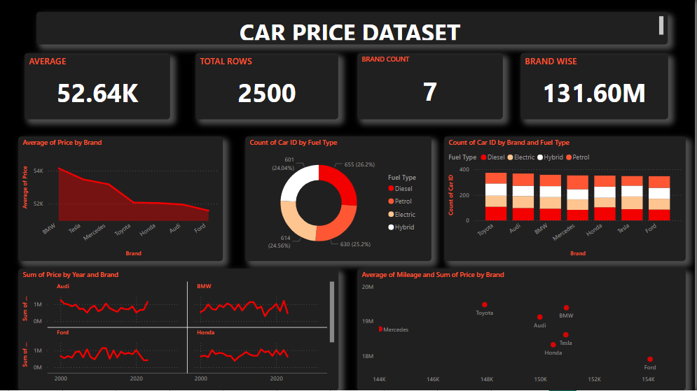

Slide 7
Insights and conclusion
BMW And Tesla Is Have Highest Average Prices.
LIKE NEW Cars Have The Highest Prices, Followed By New And Then Used Cars
Diesel Is The Most Common Fuel Type
50% Of Cars Are Priced Below ₹53,485
Most cars are post-2010
Average engine size is around 3.46 liters, ranging from 1.0 to 6.0 liters.

Slide 8
Thank you!

